Slide 1

APEX INSTITUTE OF TECHNOLOGY
DEPARTMENT OF COMPUTER SCIENCE & ENGINEERING
Computer Organization & Architecture (21CSH-281)
Faculty: Siddharth Kumar (E12853)
Lecture - 7
Instruction set architecture of a CPU: RTL Interpretation of Instructions
DISCOVER . LEARN . EMPOWER

Slide 2
Computer Organization & Architecture: Course Objectives
COURSE OBJECTIVES
The course aims to:
The purpose of the course is to introduce principles of computer organization and the basic architectural concepts.
It begins with basic organization, design, and programming of a simple digital computer and introduces simple register transfer language to specify various computer operations.
Topics include computer arithmetic, instruction set design, microprogrammed control unit, pipelining and vector processing, memory organization and I/O systems, and multiprocessors.
To familiarize Students with the detailed Architectures of a Central Processing Unit.
Learn the different types of serial communication techniques.

Slide 3
COURSE OUTCOMES
On completion of this course, the students shall be able to:-
CO1 | Identify and interpret the basics of instruction sets and their impact on the design, organization, and functionality of various functional units of a computer comparable to the CPU, memory organization, I/O organization, and parallel processors.
CO2 | Analysis of the design of arithmetic & logic unit and understanding of the fixed point and floating-point arithmetic operations.
CO3 | Relate cost performance and design trade-offs in designing and constructing a computer processor which includes memory.
CO4 | Understanding the different ways of communicating with I/O devices and standard I/O interfaces.
CO5 | Implementation of control unit techniques and the concept of Pipelining.

Slide 4
Register Transfer Language (RTL)
A digital computer system exhibits an interconnection of digital modules such as registers, decoders, arithmetic elements, and Control logic.
These digital modules are interconnected with some common data and control paths to form a complete digital system.
Moreover, digital modules are best defined by the registers and the operations that are performed on the data stored in them.
The operations performed on the data stored in registers are called Micro-operations.
The internal hardware organization of a digital system is best defined by specifying:
The set of registers and the flow of data between them.
The sequence of micro-operations performed on the data which are stored in the registers.
The control paths that initiates the sequence of micro-operation

Slide 5
The Register Transfer Language (RTL) is the symbolic representation of notations used to specify the sequence of micro-operations.
In a computer system, data transfer takes place between processor registers and memory and between processor registers and input-output systems.
These data transfer can be represented by standard notations given below:
Notations R0, R1, R2..., and so on represent processor registers.
The addresses of memory locations are represented by names such as LOC, PLACE, MEM, etc.
Input-output registers are represented by names such as DATA IN, DATA OUT and so on.
The content of register or memory location is denoted by placing square brackets around the name of the register or memory location.

Slide 6
Register transfer Language and Micro operation
In symbolic notation, it is used to describe the micro-operations transfer among registers.
It is a kind of intermediate representation (IR) that is very close to assembly language, such as that which is used in a compiler.
The term “Register Transfer” can perform micro-operations and transfer the result of operation to the same or other register.
Micro-operations : The operation executed on the data store in registers are called micro-operations. They are detailed low-level instructions used in some designs to implement complex machine instructions.
Register Transfer: The information transformed from one register to another register is represented in symbolic form by replacement operator is called Register Transfer.
Replacement Operator: In the statement, R2 <- R1, <- acts as a replacement operator. This statement defines the transfer of content of register R1 into register R2.

Slide 7
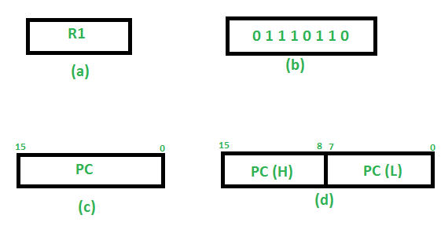
There are various methods of RTL –
1. General way of representing a register is by the name of the register in closed in a rectangular box as shown in (a).
2. Register is numbered in a sequence of 0 to (n-1) as shown in (b).
3. The numbering of bits in a register can be marked on the top of the box as shown in (c).
4. A 16-bit register PC is divided into 2 parts- Bits (0 to 7) are assigned with lower byte of 16-bit address and bits (8 to 15) are assigned with higher bytes of 16-bit address as shown in (d)

Slide 8
Basic symbols of RTL
Symbol | Description | Example
Letters and Numbers | Denotes a Register | MAR, R1, R2
( ) | Denotes a part of register | R1(8-bit) R1(0-7)
<- | Denotes a transfer of information | R2 <- R1
, | Specify two micro-operations of Register Transfer | R1 <- R2 R2 <- R1
: | Denotes conditional operations | P : R2 <- R1 if P=1
Naming Operator (:=) | Denotes another name for an already existing register/alias | Ra := R1

Slide 9
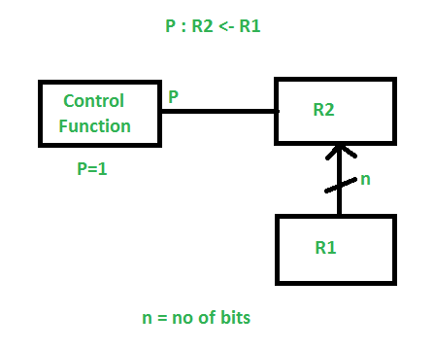
Register Transfer Operations
The operation performed on the data stored in the registers are referred to as register transfer operations.
There are different types of register transfer operations:
1. Simple Transfer – R2 <- R1: The content of R1 are copied into R2 without affecting the content of R1. It is an unconditional type of transfer operation.
2. Conditional Transfer – It indicates that if P=1, then the content of R1 is transferred to R2. It is a unidirectional operation.

Slide 10
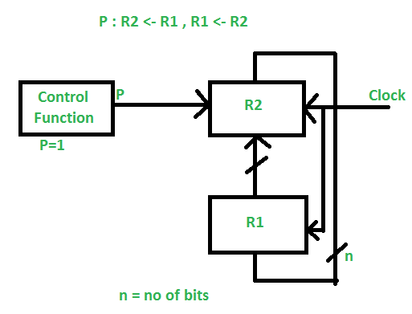
3. Simultaneous Operations – If 2 or more operations are to occur simultaneously then they are separated with comma (,).
If the control function P=1, then load the content of R1 into R2 and at the same clock load the content of R2 into R1.

Slide 11
Summary
Discussed about Register Transfer Language (RTL).
Discussed about Micro-operations.
Discussed about Register Transfer.
Assessment Questions
Q1. What are micro operations?
Q2. What are different operations of RTL?
Q3. What are replacement operators?
Q4. What is simultaneous operation in RTL?

Slide 12
THANK YOU

